Slide 1

Group 15 Embedded Systems
Thomas Durston
Guy Richardson
Matthew Price
Ashley Harris
Alice Cole
Alex Rigas
Fraser McDonald
Jason Choo

Slide 2
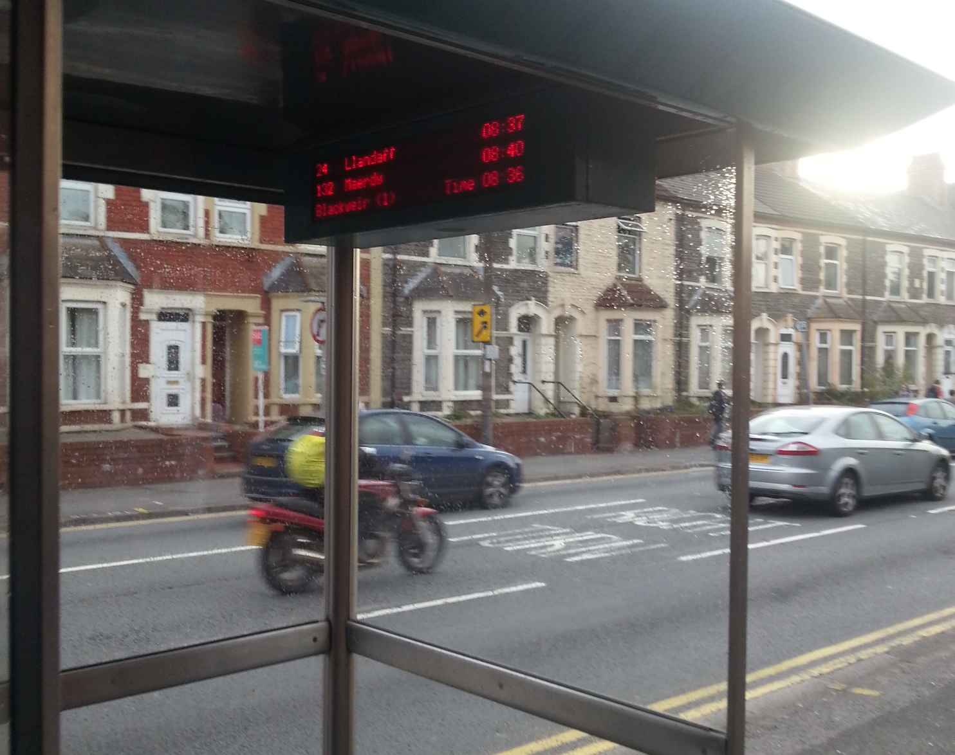
Bus arrival time
Display shows the times that busses will arrive based on GPS location. This could take into account the speed of the bus and even traffic.
Location: Column Road

Slide 3
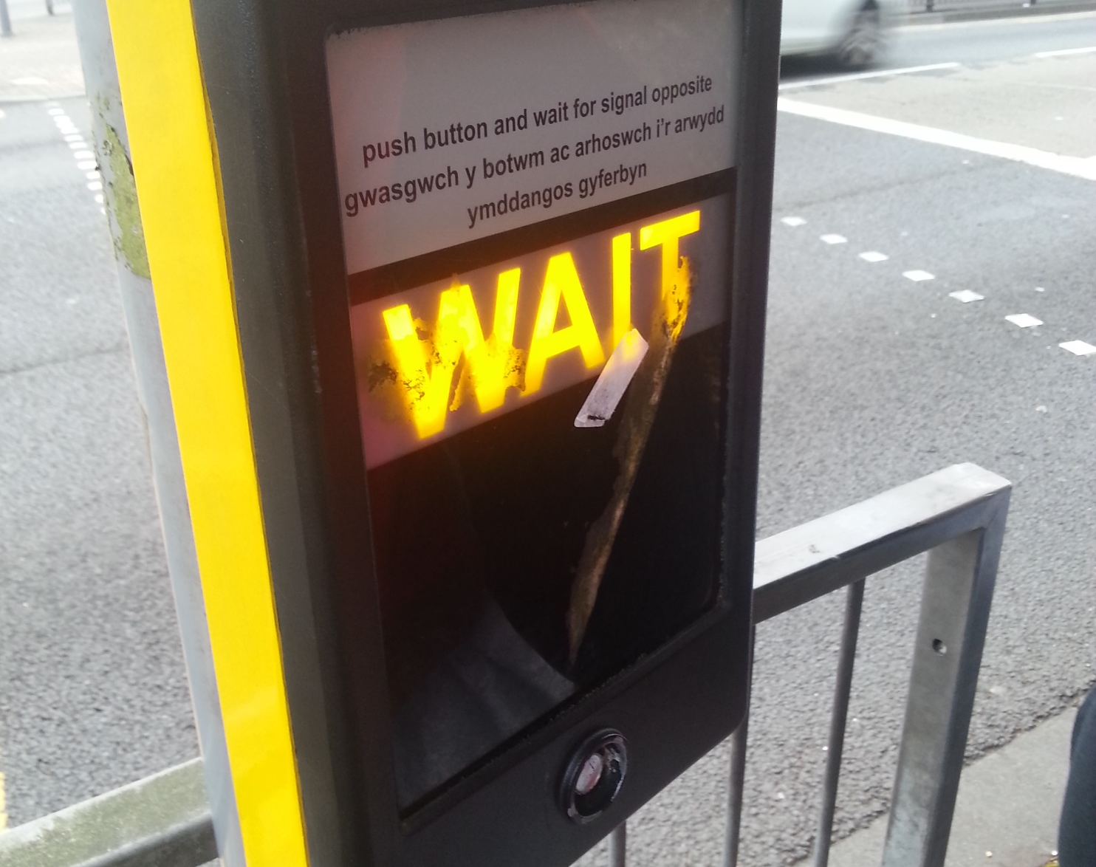
Traffic Light Trigger
When the pedestrian presses the button, A signal is sent indicating that they would like to cross the road. The traffic light system will respond by changing the green light to red informing the road users that they have to stop.
Location: Cardiff Central

Slide 4
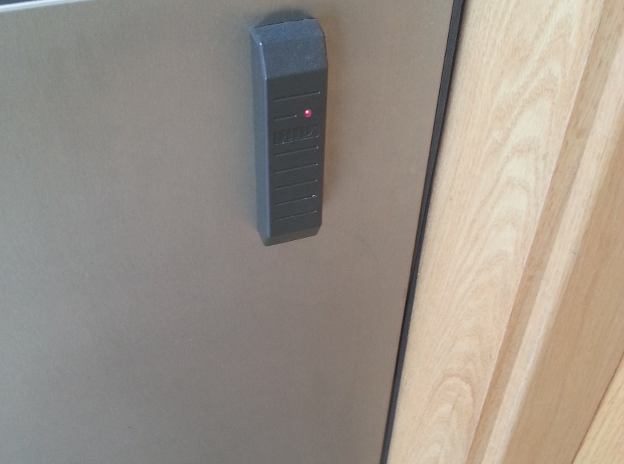
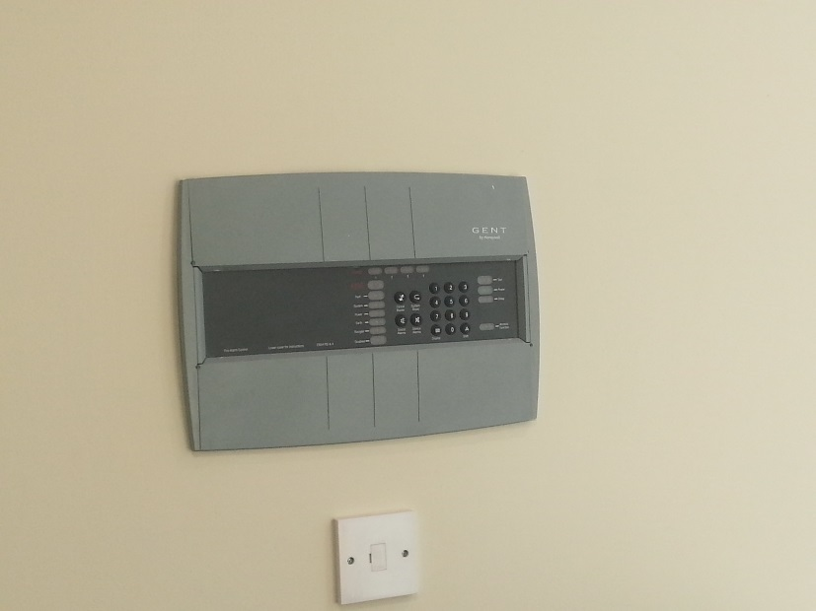
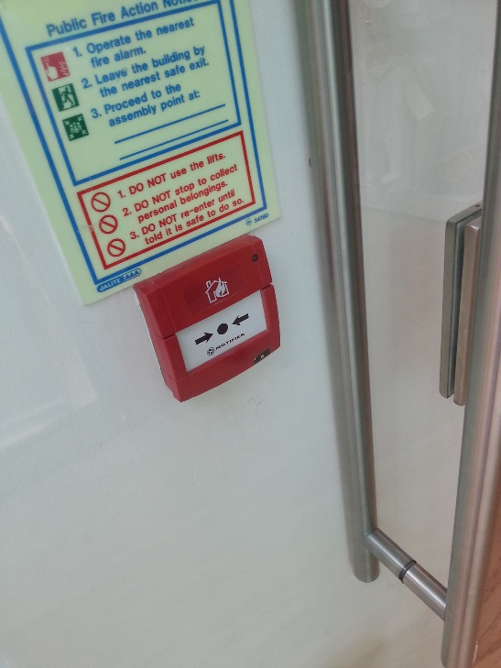
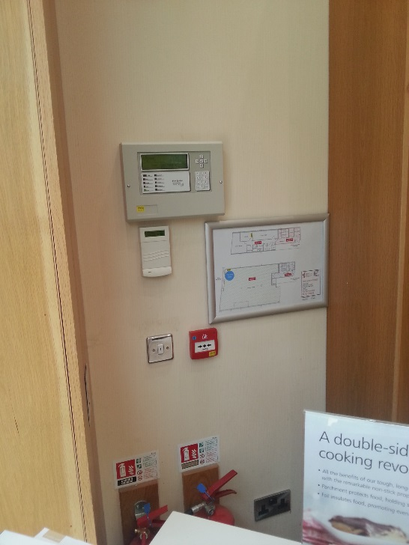
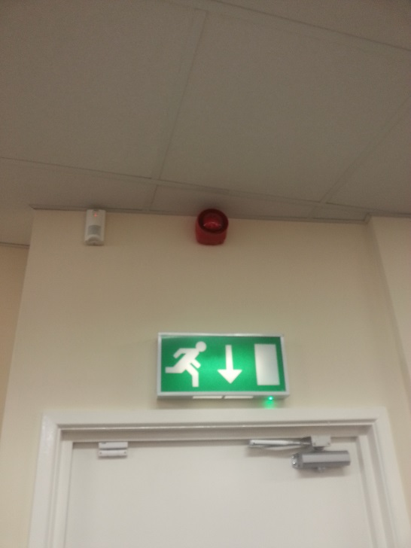
Security and Alarms
The majority of shops and other buildings have security and or fire alarm systems.
Security systems are generally triggered automatically when something i.e a security tag passes through a sensor, sounding the alarm and informing staff, there are sometimes manual overrides such as switches for staff to trigger manually if they feel threatened or notice suspicious behaviour.
Fire systems operate in a similar manner, automatically triggered if a fire is detected or manually triggered by a person if they encounter a fire before the automatic alarm is triggered. Modern fire alarms also send alerts to the local fire brigade.
Location: St. Davids Centre

Slide 5
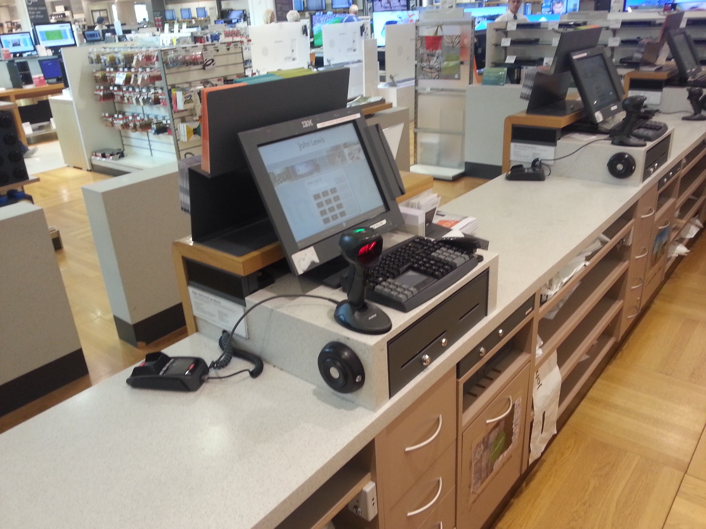
EPOS
EPOS- Electronic point of sale
Barcodes of items are scanned and stock databases are checked in order to retrieve the price, number in stock and other information. Once the payment has been processed whether it be cash or electronic payment an itemised receipt is produced.
Location: John Lewis

Slide 6
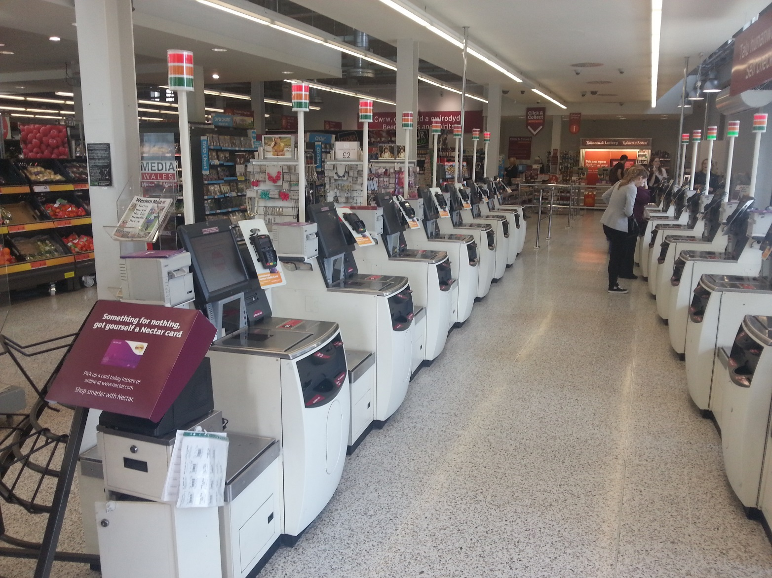
Self Checkout
Offers a quicker method of payment. Same EPOS system however normally the software is more user friendly enabling anyone to check out successfully.
Location: Sainsburys

Slide 7
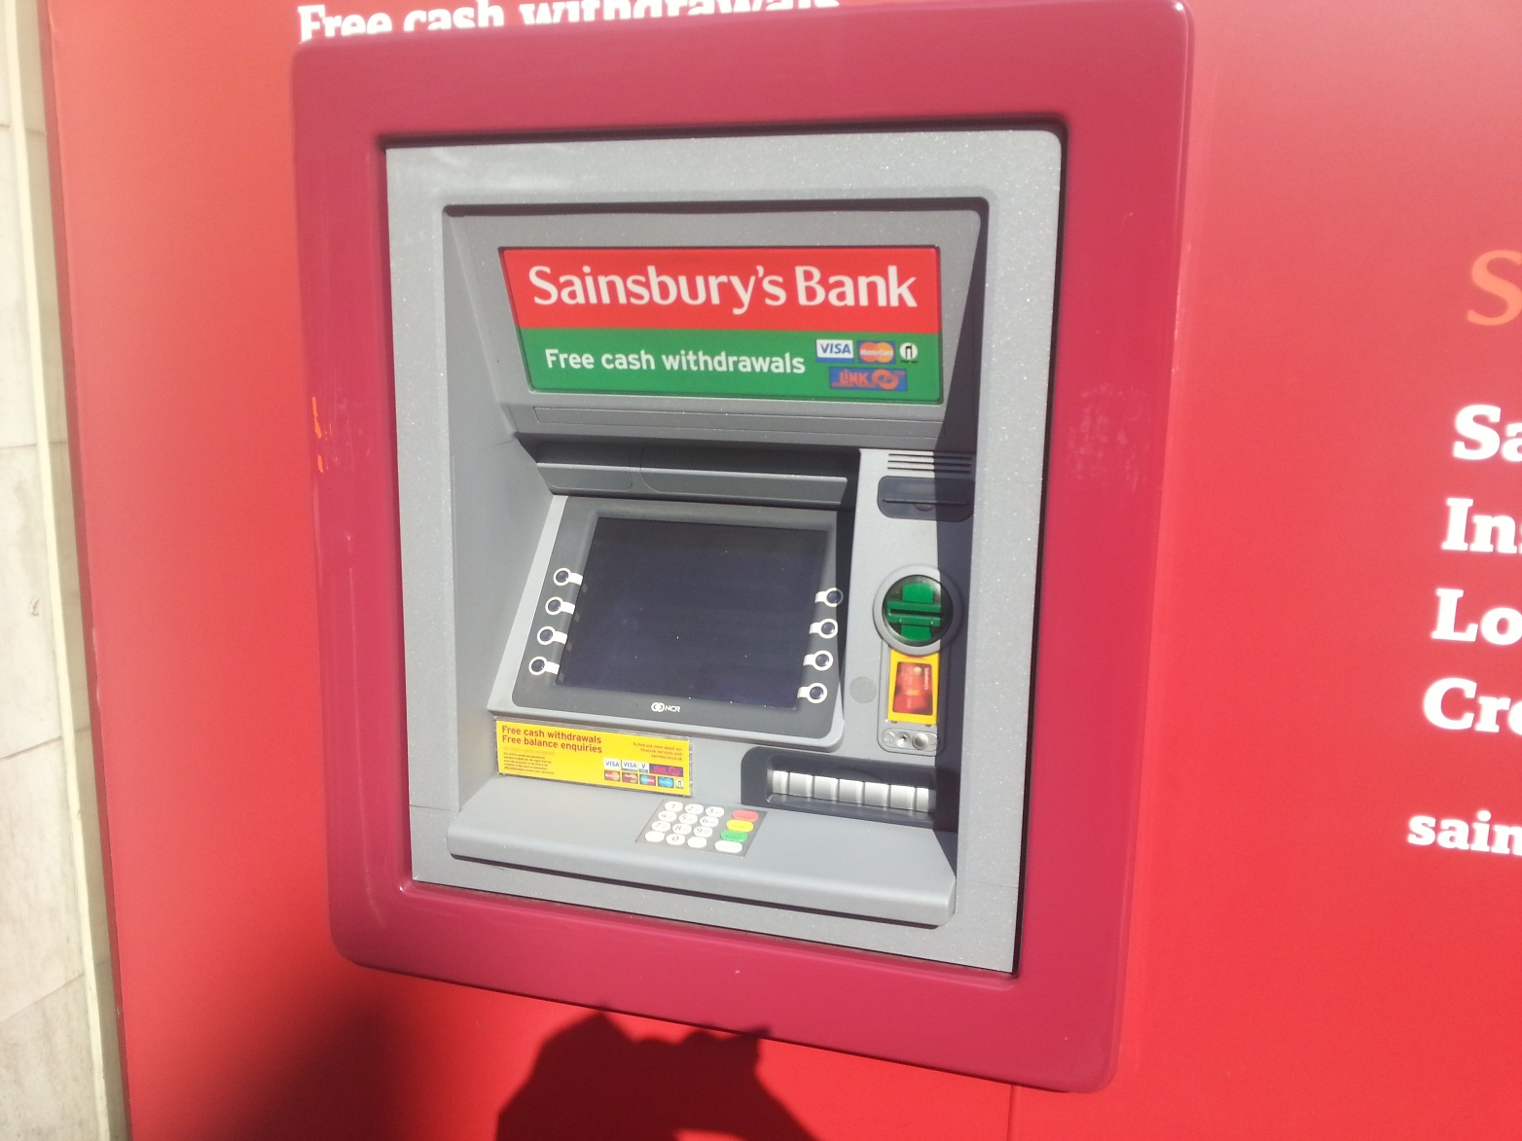
ATM
ATM-Automated Teller Machine
Information is read from the chip in your card and verified with your PIN, the bank is then contacted and allows you to perform tasks such as checking balance or withdrawing available funds
Location: Sainsburys

Slide 8
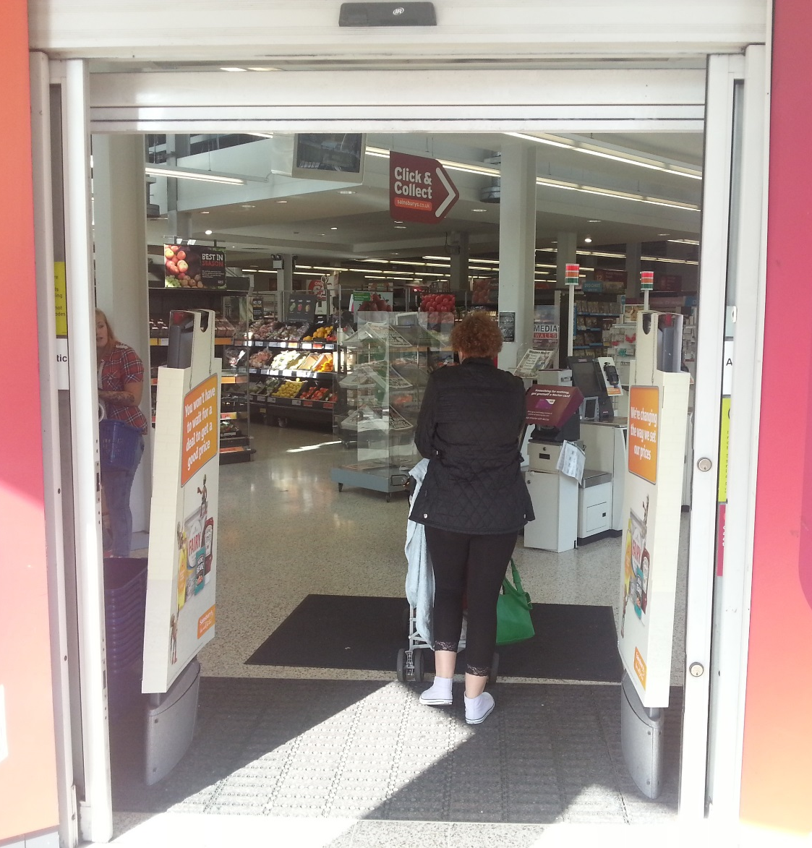
Automatic Doors
A sensor above the doorway detects movement near the door. Some automatic door systems use floor mats which detect pressure when somebody walks over them. Once movement is detected the door opens allowing the person access. Being electronic the doors can be automatically locked at closing times.
Location: Anonymous Shop (Definitely not Sainsburys)

Slide 9
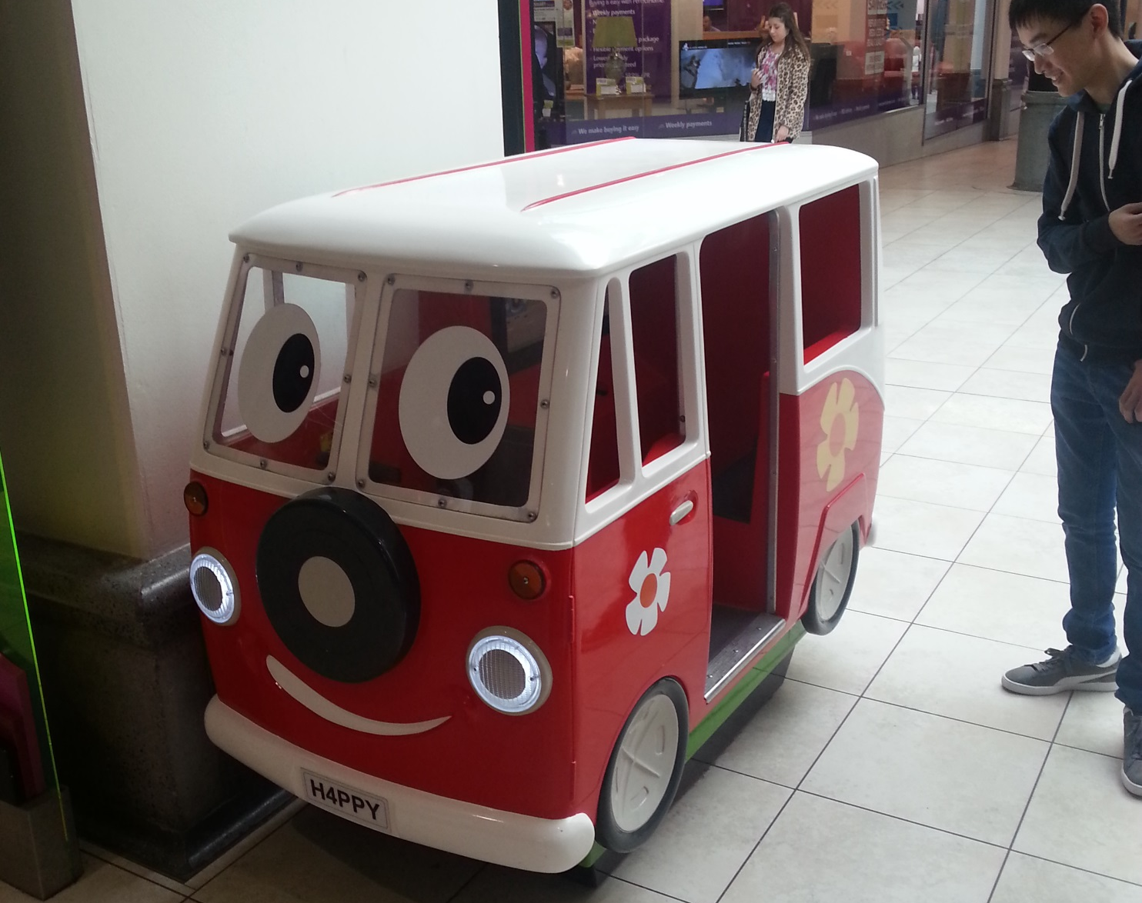
H4ppy The Bus
Children's ride
Containing interactive screen and buttons for the fun
NOT SUITABLE FOR ANYONE OVER 4 FOOT

